Slide 1
#MathsConfMini
The 1, 2, 3, of Autograph

Slide 2
The 1, 2, 3 of Autograph
Autograph 5 is free for all to download from the Complete Maths link:
https://www.completemaths.com/autograph

Slide 3
1 point
Point Mode: Point and click
Main: Enter Co-ordinates (x and y)
Can include parameters
Can be locked
Main: Edit/show label
Hide point
Trace point
Point: XY Attribute Point (enter attributes)
Line: Horizontal Line
Vertical Line
Gradient Line (enter gradient)
Fixed Length Line (enter length)
Circle: Circle (enter radius)
Vector: Vector (enter a, b)
Transform: reflection in an axis
shear along an axis
stretch along an axis
Matrix transformation

Slide 4
2 Points
Create: Quadratic (3 pts)
Quadratic x = f(y)
Cubic (3 pts + gradient)
Best Fit Polynomial
Angle
Shaded Area

Slide 5
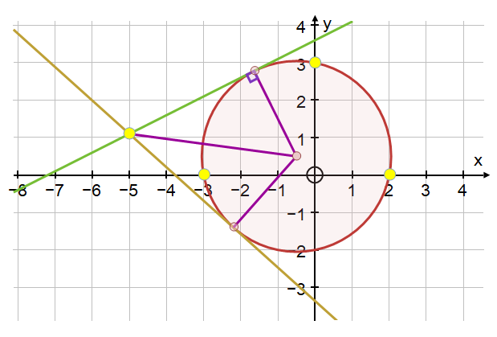
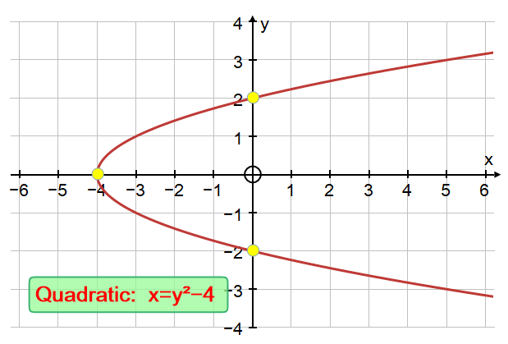
3 Points
Main: Group to Shape
Point: Mean
Line: Angle Bisector
x-on-y Regression Line
y-on-x Regression Line
Circle: Circle (3 pts)
Centre of Circle
Sector
Sector (with centre)
Segment
Segment (with centre)
Arc
Arc (with centre)
Ellipse
Create: Quadratic (3 pts)
Quadratic x = f(y)
Cubic (3 pts + gradient)
Best Fit Polynomial
Angle
Shaded Area

Slide 6
Find more:
Beginner: https://courses.completemaths.com/autograph-lesson-ideas-for-beginners
Intermediate: https://courses.completemaths.com/autograph-intermediate-lesson-ideas
Advanced: https://courses.completemaths.com/autograph-advanced-lesson-ideas

Slide 7
Thank you

