Slide 2
Bonds to Binomials

Slide 3
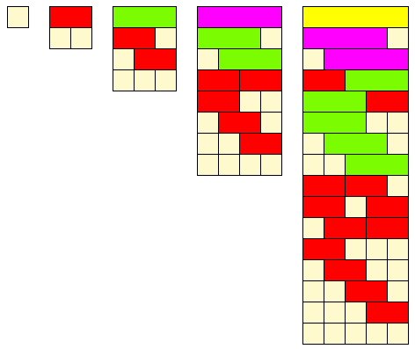
Number bonds
How many ways can you write four as a sum of other whole numbers?
Target | One number | Two numbers | Three numbers | Four numbers | Five numbers | Total ways
1 | 1 |  |  |  |  | 1
2 | 2 | 1+1 |  |  |  | 2
3 | 3 | 1+2 2+1 | 1+1+1 |  |  | 4
4 | 4 | 1+3 3+1 2+2 | 1+1+2 1+2+1 2+1+1 | 1+1+1+1 |  | 8
5 | 5 | 1+4 4+1 2+3 3+2 | 1+1+3 1+3+1 3+1+1 1+2+2 2+1+2 2+2+1 | 1+1+1+2 1+1+2+1 1+2+1+1 2+1+1+1 | 1+1+1+1+1 | 16
$$2^{0}$$
$$2^{1}$$
$$2^{2}$$
$$2^{3}$$
$$2^{4}$$

Slide 4
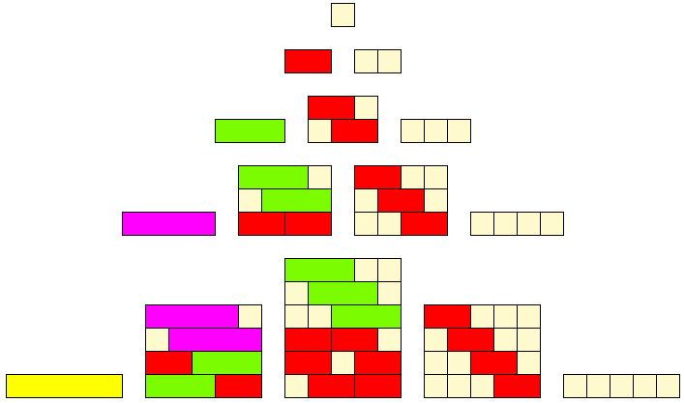
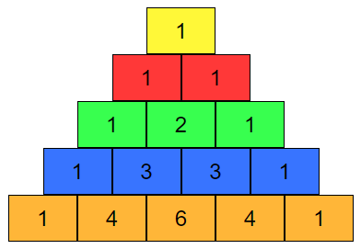
Pascal’s Triangle
How many ways can you write a whole number as a sum of other whole numbers?
Target | One number | Two numbers | Three numbers | Four numbers | Five numbers | Total ways
1 | 1 |  |  |  |  | 1
2 | 2 | 1+1 |  |  |  | 2
3 | 3 | 1+2 2+1 | 1+1+1 |  |  | 4
4 | 4 | 1+3 3+1 2+2 | 1+1+2 1+2+1 2+1+1 | 1+1+1+1 |  | 8
5 | 5 | 1+4 4+1 2+3 3+2 | 1+1+3 1+3+1 3+1+1 1+2+2 2+1+2 2+2+1 | 1+1+1+2 1+1+2+1 1+2+1+1 2+1+1+1 | 1+1+1+1+1 | 16

Slide 5
Binomial Expansion
Expand and simplify:
$${\left(x+y\right)}^{0}=1$$
$${\left(x+y\right)}^{1}=1x+1y$$
$${\left(x+y\right)}^{2}={1x}^{2}+2xy+{1y}^{2}$$
$${\left(x+y\right)}^{3}={1x}^{3}+3x^{2}y+{3xy}^{2}+{1y}^{3}$$
$${\left(x+y\right)}^{4}={1x}^{4}+4x^{3}y+{6x^{2}y}^{2}+4xy^{3}+{1y}^{4}$$

Slide 6
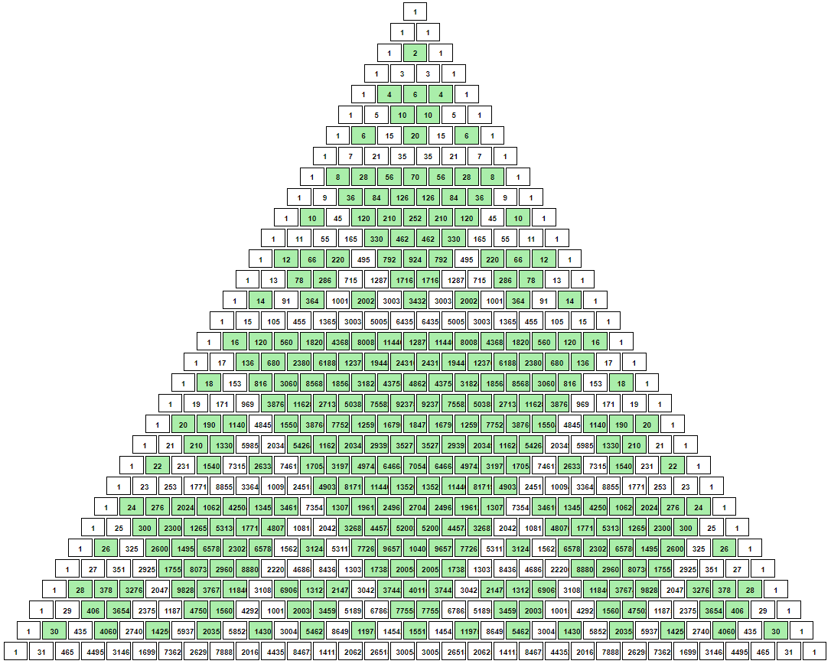
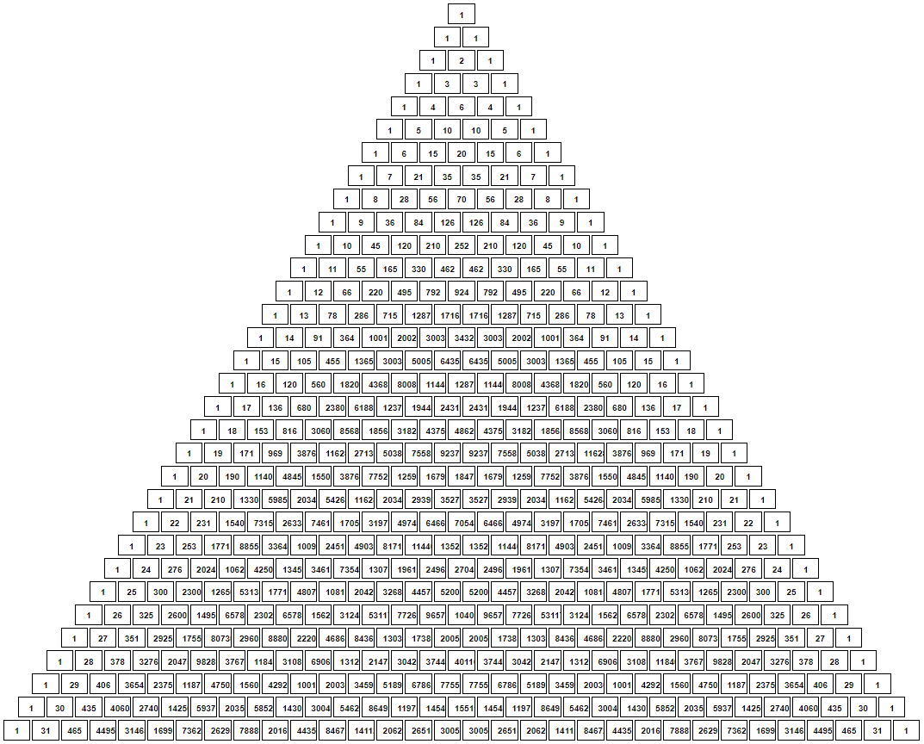
Sierpinski triangle

Slide 7
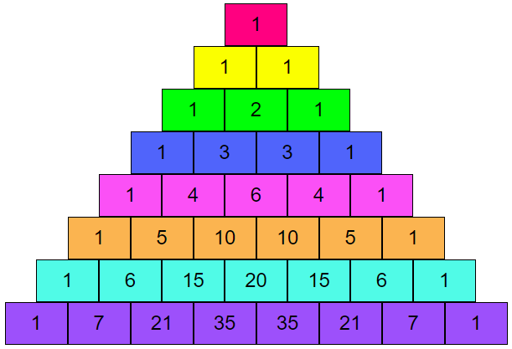
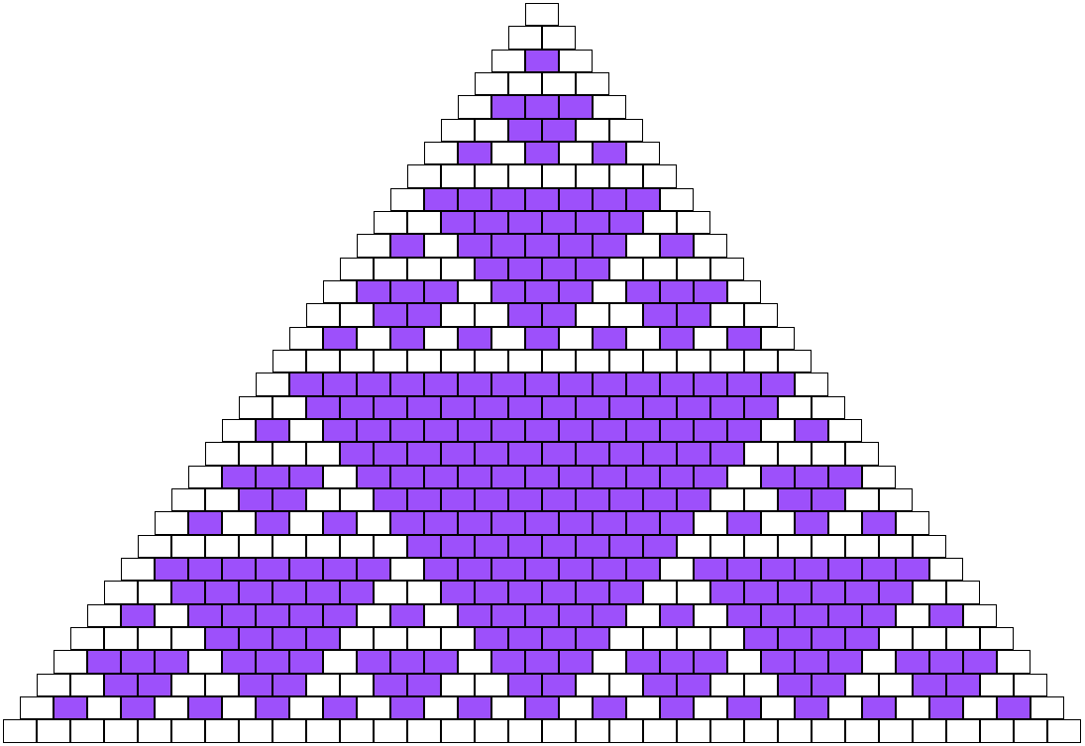
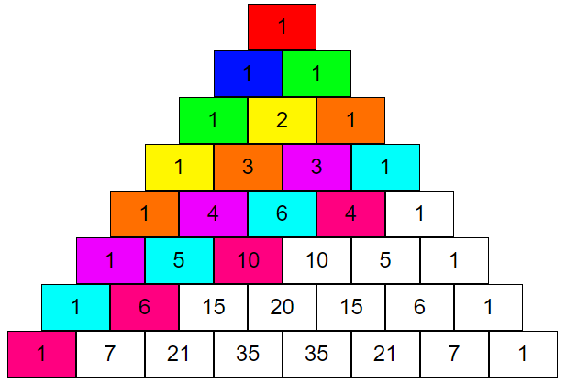
Pascal’s Triangle
Powers of 2
Odd and Even Numbers
Fibonacci

Slide 8
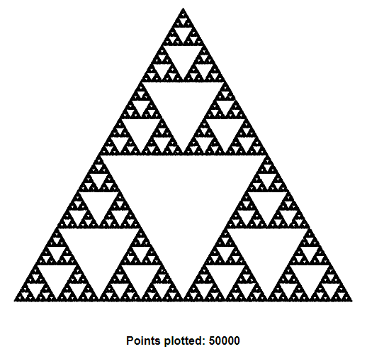
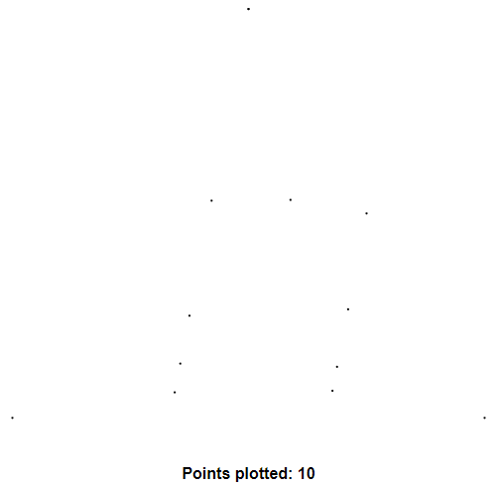
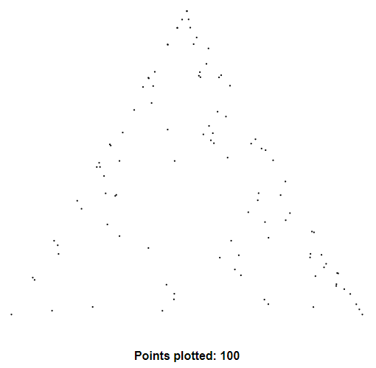
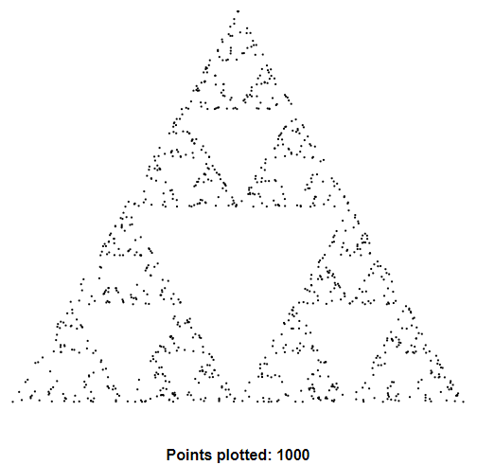
Chaos
mathsbot.com/activities/chaos

Slide 9
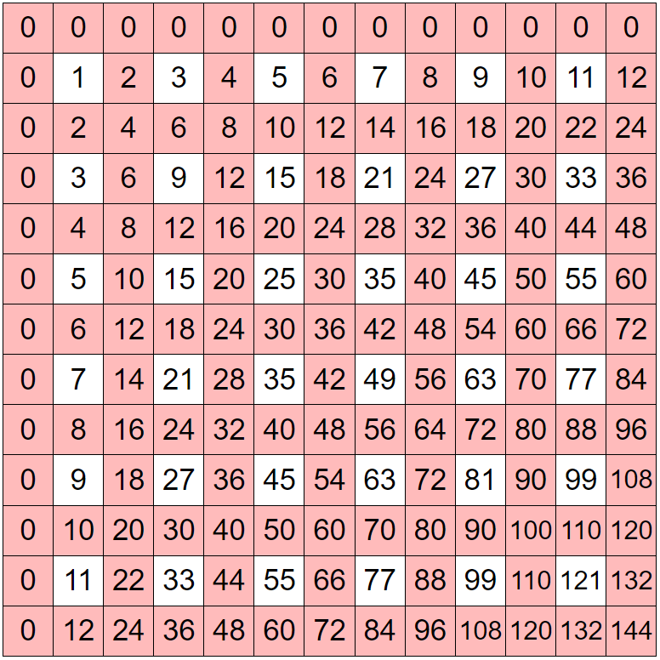
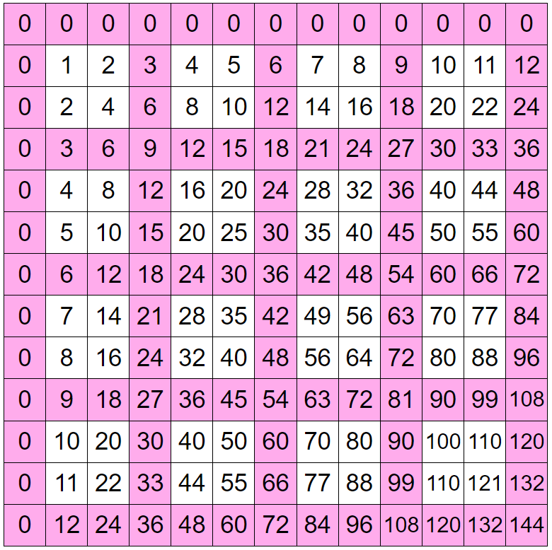
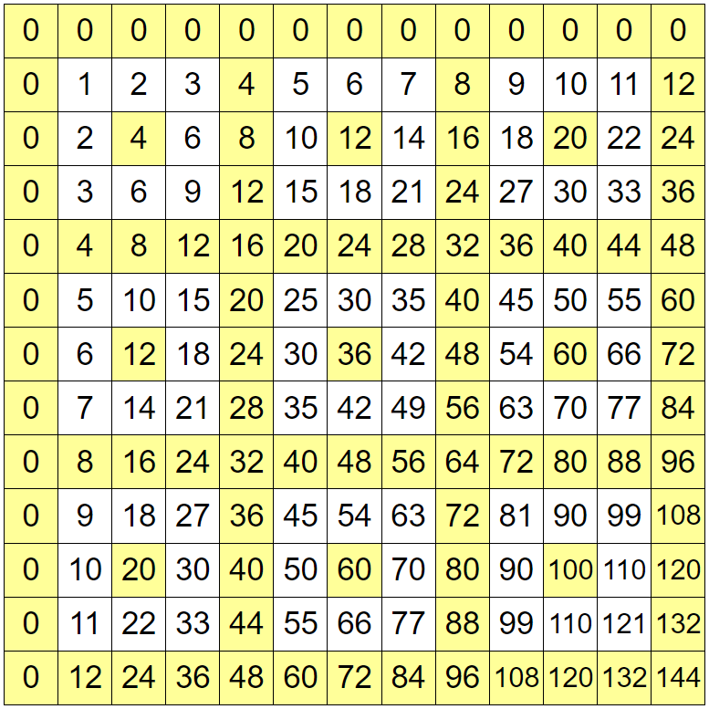
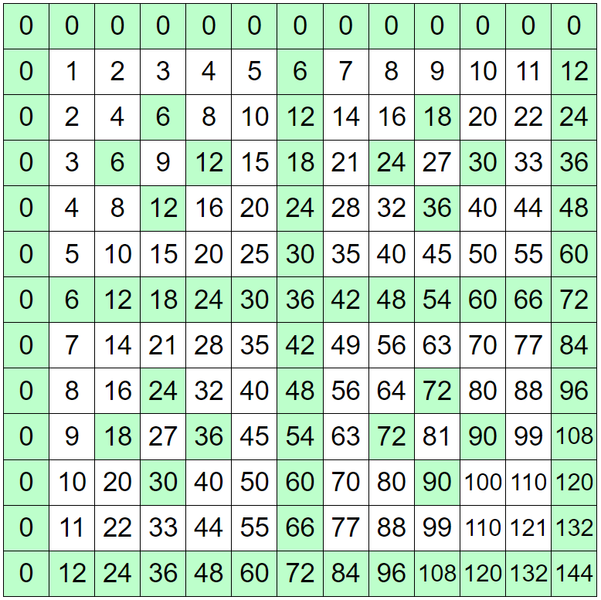
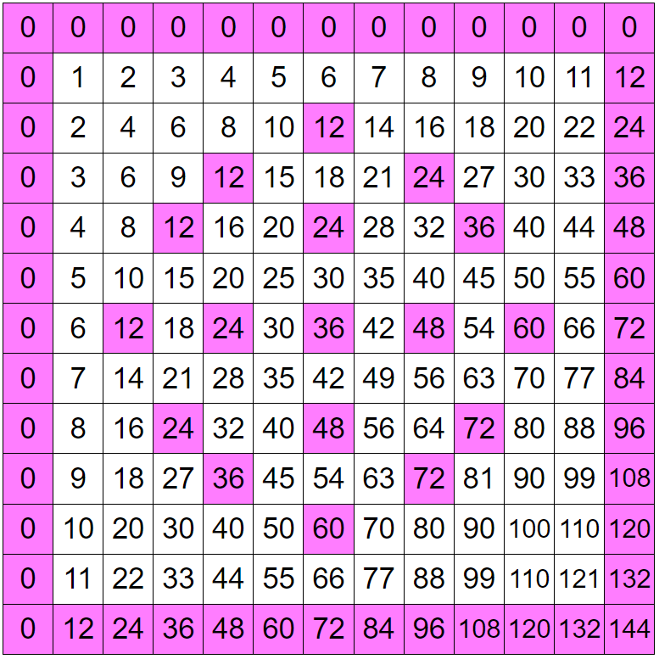
Multiplication Tables
mathsbot.com/tools/timesTables

Slide 10
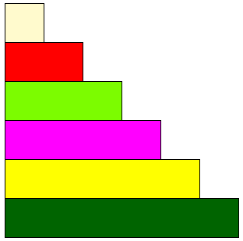
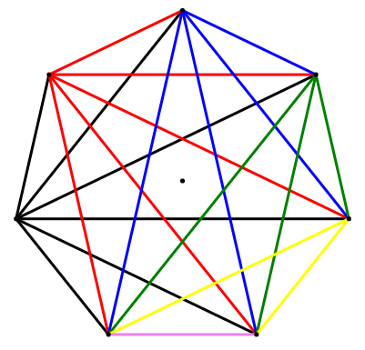
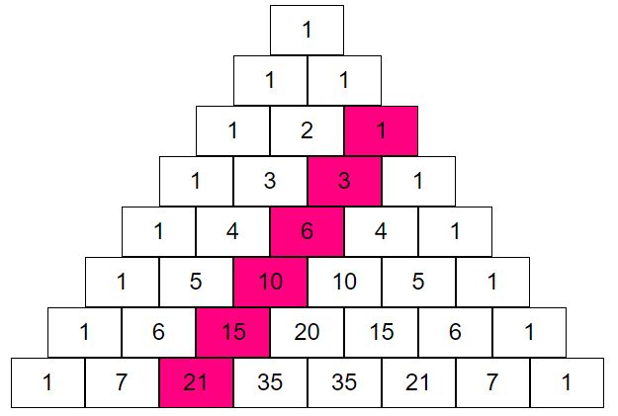
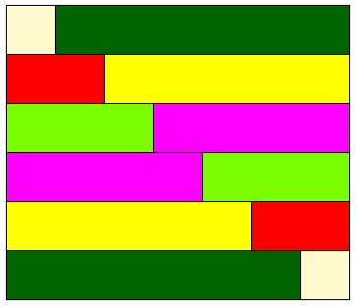
Triangle Numbers
Seven people each shake hands with each other once. How many handshakes are there?
Triangle Numbers

Slide 11
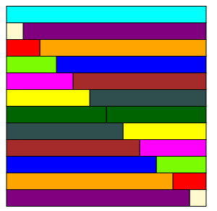
Ignoring it’s July for a moment…
How many presents were given in total during the 12 days of Christmas?
$$1+3+6+10+15+21+28+36+45+55+66+78$$
$${=2}^{2}+4^{2}+6^{2}+8^{2}+{10}^{2}+{12}^{2}$$
$$=4(1^{2}+2^{2}+3^{2}+4^{2}+5^{2}+6^{2})$$
$$=364$$

Slide 12
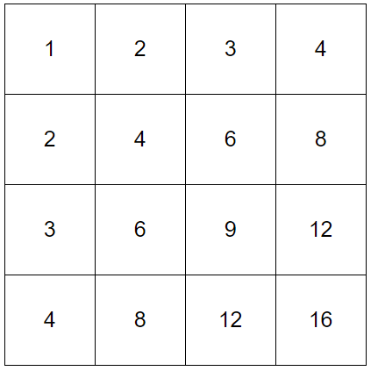
Table Sums
What is the sum of all the numbers in a 4 × 4 multiplication table?
Specialise: Start with smaller grids.
Conjecture: What do you add when you increase the grid size?
Generalise: n × n board?

Slide 13
Table Sums
Size | Row Sum | Row Total | Grand Total
1 × 1
2 × 2
3 × 3
4 × 4 | 1 + 2 + 3 + 4 | 10 | 100
5 × 5
6 × 6
n × n

Slide 14
Table Sums
Size | Row Sum | Row Total | Grand Total
1 × 1 | 1 | 1 | 1
2 × 2 | 1 + 2 | 3 | 9
3 × 3 | 1 + 2 + 3 | 6 | 36
4 × 4 | 1 + 2 + 3 + 4 | 10 | 100
5 × 5 | 1 + 2 + 3 + 4 + 5 | 15 | 225
6 × 6 | 1 + 2 + 3 + 4 + 5 + 6 | 21 | 441
n × n | 1 + 2 + ,,, + n | $\frac{\text{n}\text{(}\text{n}\text{ + 1)}}{2}$ | ($\frac{\text{n}\text{(}\text{n}\text{ + 1)}}{2}$)²

Slide 15
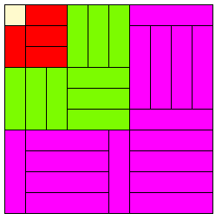
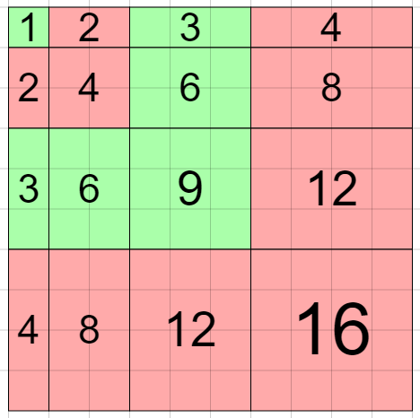
Table Sums
$$(1+2+3+4)²=1³+2³+3³+4³$$

Slide 16
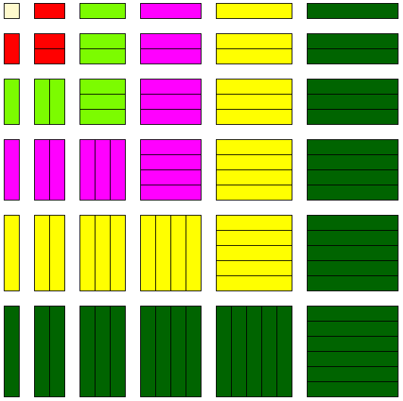
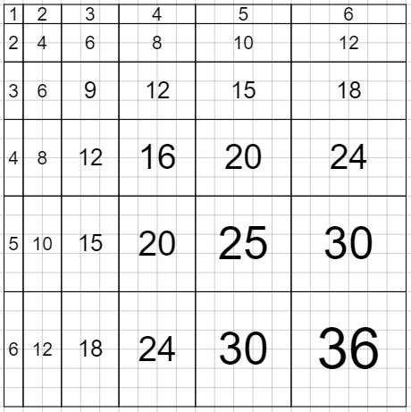
Scaled Tables

Slide 17
FDP and Ratio

Slide 18
Percentages of Amounts
32% of 25
25% of 32
% | Amount
100 | 25
10 | 2.5
30 | 7.5
1 | 0.25
2 | 0.5
32 | 8
% | Amount
100 | 25
50 | 16
25 | 8

Slide 19
FDP and Ratio
Find $\frac{2}{5}$of 20
20 ÷ 5 = 4
4 × 2 = 8
Work out 40% of 20.
10% of 20 = 2
40% of 20 = 2 × 4 = 8
Share 20 in the ratio 2:3
2 + 3 = 5
20 ÷ 5 = 4
4 × 2 = 8 and 4 × 3 = 12
Calculate 20 × 0.4
20 × 4 = 80
80 ÷ 10 = 8
Now generate a set of similar problems where the solution is…

Slide 20
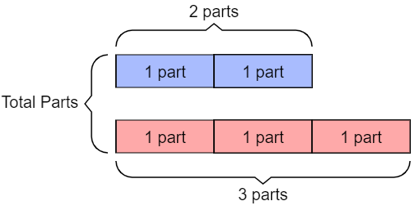
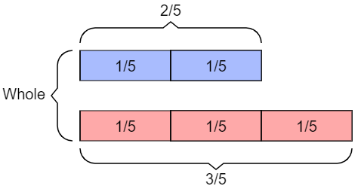
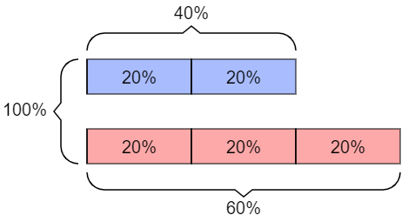
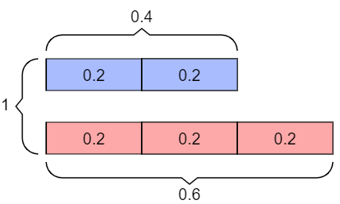
Connecting FDP and Ratio
Ratio
Fractions
Percentages
Decimals

Slide 21
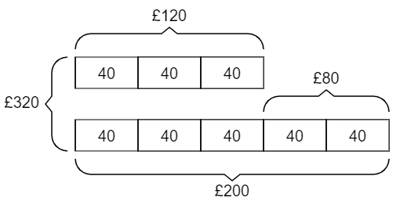
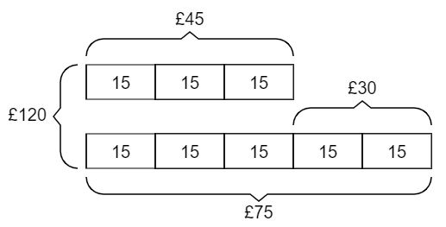
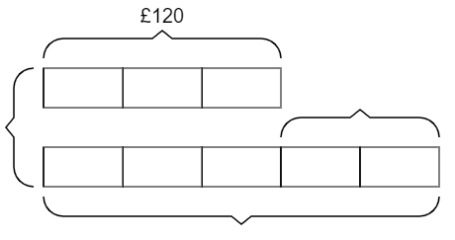
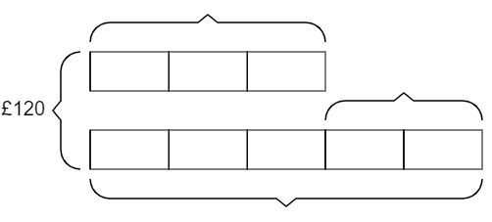
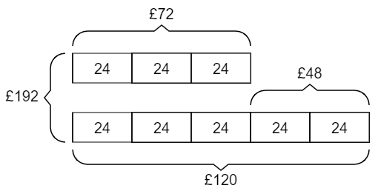
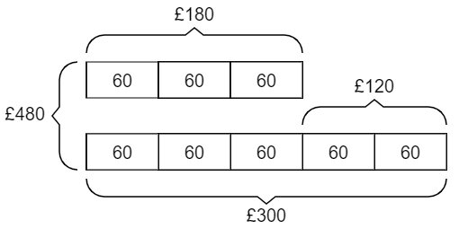
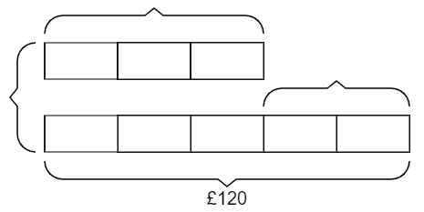
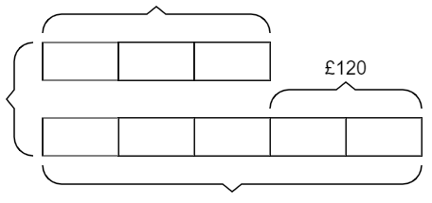
Sharing in a ratio
Anna and Bob shared some money in the ratio 3:5.
a) If the total shared was £120, what else can you work out?
b) If Anna received £120, what else can you work out?
c) If Bob received £120, what else can you work out?
d) If Bob received £120 more than Anna, what else can you work out?

Slide 22
Ratio Tables

Slide 23
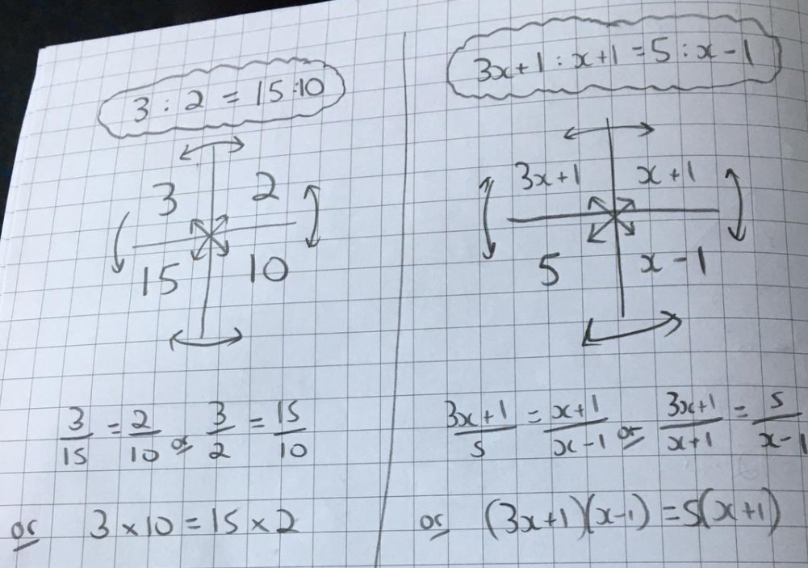
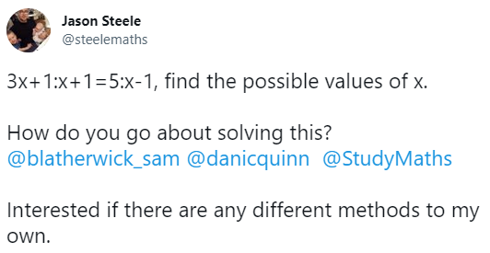
Ratio Tables
3 : 2 = 15 : x
3x + 1 : x + 1 = 5 : x - 1

Slide 24
Ratio Tables
Distance (Miles) | Time (Min)
72 | 60
x | 20
A Cheetah runs at an average speed of 72 mph for 20 minutes. How far did it travel?
Distance (Miles) | Time (Min)
10 | 10
x | 60
A Mako shark takes 10 minutes to travel 10 miles.
What is its average speed?
Distance (Miles) | Time (Hours)
0.01 | 1
1 | x
A sea horse travels at 0.01 mph.
How long will it take to travel a mile?

Slide 25
Ratio Tables
Monday | Tuesday
90 | 20
x | 120

Slide 26
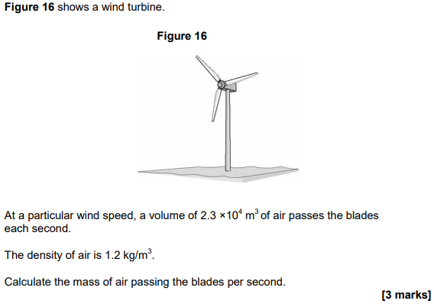
Ratio Tables
Mass (Kg) | Volume (m³)
$$1.2$$ | $$1$$
x | $$2.3×{10}^{4}$$

Slide 27
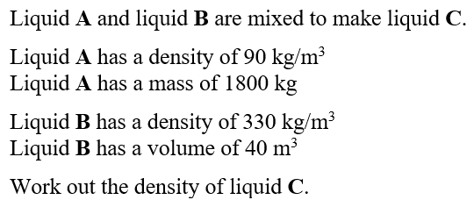
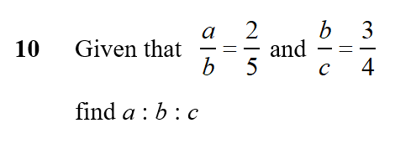
Ratio Tables
a | b
2 | 5
b | c
3 | 4
A
kg | m³
90 | 1
1800
B
kg | m³
330 | 1
 | 40
C
kg | m³
 | 1
a | b
6 | 15
b | c
15 | 20
250
20
13200
15000
60

Slide 28
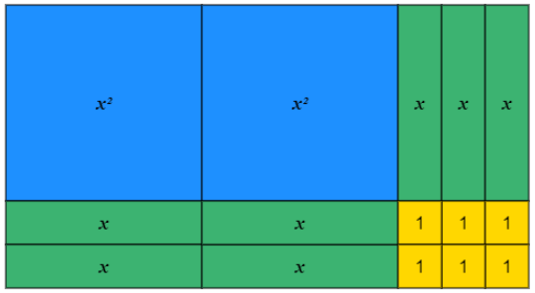
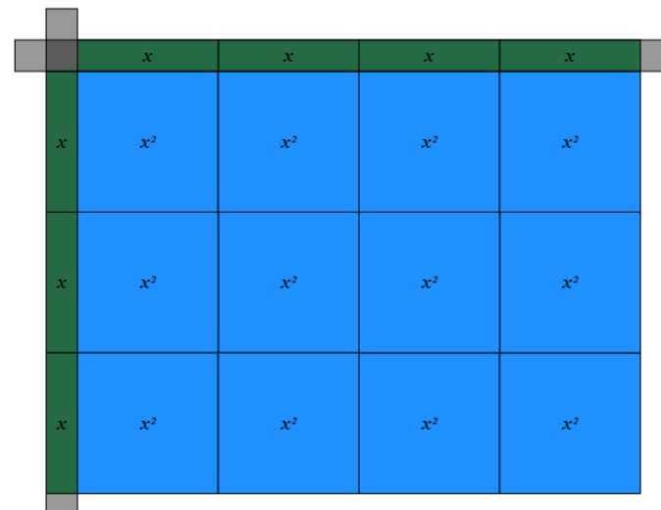
Ratio Tables
Factorise ${2x}^{2}+7x+6$
$$=(2x+3)(x+2)$$
$$×$$ | $$2x$$ | $$+3$$
$$x$$ | $${2x}^{2}$$ | $$3x$$
$$+2$$ | $$4x$$ | $$6$$
$$2x^{2}×6=3x×4x$$

Slide 29
Product Rule for Counting

Slide 30
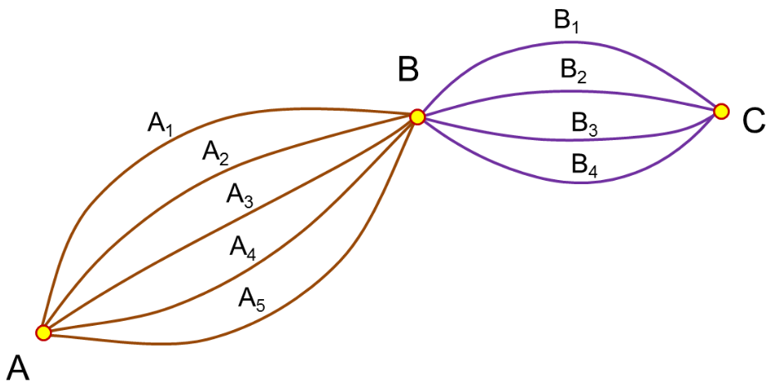
How many routes from A to C?
donsteward.blogspot.com

Slide 31
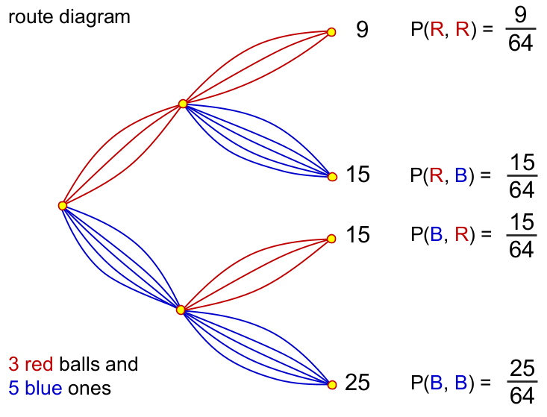
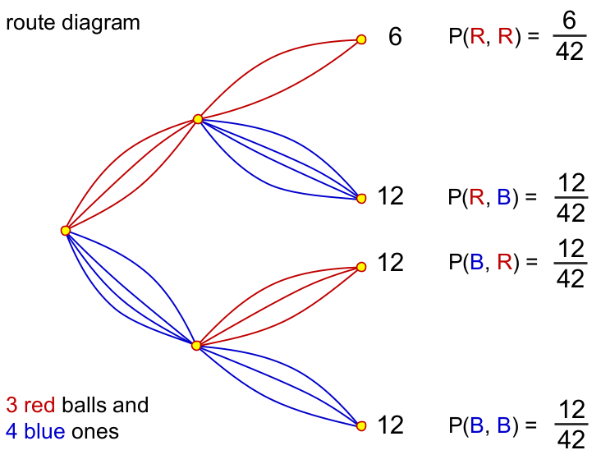
With and without replacement
donsteward.blogspot.com

Slide 32
Directed Number

Slide 33
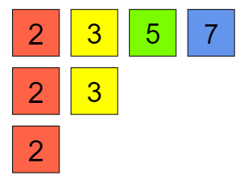
One of my favourite 4-digit numbers…
2520
The smallest integer with all the numbers from 1 to 10 as factors.

Slide 34
How many factors does 2520 have?
$2^{3}$ × $3^{2}$ × 5 × 7 = 2520
$3^{0}$
$2^{0}$
$5^{0}$
$3^{1}$
$7^{0}$
$2^{1}$
$3^{2}$
$5^{1}$
$2^{2}$
$7^{1}$
$2^{3}$
Each factor of 2520 contains a factor of:
1, 2, 4, or 8
1, 3, or 9
1, or 5
1, or 7
2520 has 4 × 3 × 2 × 2 = 48 factors.

Slide 35
Pythagoras and Trigonometry

Slide 36
Pythagoras and Surds
How many different lengths can you draw on a 5 × 5 grid?
Work systematically.
How can you count them all?
What about different grid sizes?

Slide 37
Pythagoras and Surds
So what about an n × n grid?

Slide 38
Line Segments
d) What would the equation of the line be?

Slide 39
“Tri-Thagoras”
y
c
3
x
4

Slide 40
Trigonometry and Sine rule
5
x
35°
Right-angled Trigonometry
Sine Rule
$$\sin{35}=\frac{x}{5}$$
$$\frac{x}{\sin{35}}=\frac{5}{\sin{90}}$$
$$x=\frac{5\sin{35}}{\sin{90}}$$
$$x=5\sin{35}$$

Slide 41
Pythagoras and Cosine rule
x
9
12
Pythagoras
Cosine Rule
$$x^{2}=9^{2}+{12}^{2}$$
$$x^{2}=9^{2}+{12}^{2}−2\left(9\right)\left(12\right)\cos{90}$$
$$x^{2}={225}^{2}$$
$$x^{2}={225}^{2}−216\cos{90}$$

Slide 42
Indices and Bases

Slide 43
How big is one million?

Slide 44
Indices and Bases
Simplify: $4^{3}+4^{3}+4^{3}+4^{3}$
$${4(4}^{3})=4^{4}$$

Slide 45
Making Connections

Slide 46
Averages and Algebra
a | 4a | a² | a + 8 | Ordered Values | Median | Range
0 | 0 | 0 | 8 | 0, 0, 0, 8 | 0 | 8
1 | 4 | 1 | 9 | 1, 1, 4, 9 | 2.5 | 8
2 | 8 | 4 | 10 | 2, 4, 8, 10 | 6 | 8
3
4
What patterns can you spot in each column?
Will the range always be 8?
Will the median ever be larger than the range?
Can you find a value of a which gives a median of 24 and a range of 56?
Can you find a value of a so that the median is equal to the range?

Slide 47
Venns and Two-way tables

Slide 48
Completing the Square
146
x² + 4x + 6
(10 + 2)² + 2
(x + 2)² + 2

Slide 49
Using these 9 pieces of Dienes base 10 equipment, what numbers can you make by choosing three?
How many different amounts are there?
What do you notice about the difference between consecutive totals?
How could you extend or develop this task?

Slide 51
Quadratic Sequences
Next term?
10th term?
n^{th} term?

Slide 52
Proportion Problems
A farmer has 3 animals and a pile of hay.
The cow and a horse could eat all the hay in 45 days.
The cow and a sheep could eat all the hay in 60 days.
The horse and a sheep could eat all the hay in 90 days.
How long would it take the cow, horse and sheep to eat all the hay?

Slide 53
Proportion Problems
Cows | Horse | Sheep | Days | Piles of Hay
1 | 1 | 0 | 45 | 1
1 | 0 | 1 | 60 | 1
0 | 1 | 1 | 90 | 1
1 | 1 | 0 | 90 | 2
1 | 0 | 1 | 90 | 1.5
2 | 2 | 2 | 90 | 4.5
2 | 2 | 2 | 180 | 9
2 | 2 | 2 | 20 | 1
1 | 1 | 1 | 40 | 1

Slide 54
A consistent picture
14 × 12 = 100 + 40 + 20 + 8
= 100 + 60 + 8
(x + 4)(x + 2) = x² + 4x + 2x + 8
= x² + 6x + 8

Slide 55
Base x
14 × 13 = 100 + 40 + 30 + 12
= 1(100) + 7(10) + 12
= 1(100) + 8(10) + 2
(x + 4)(x + 3) = x² + 4x + 3x + 12
= x² + 7x + 12
Can’t exchange in base x!

Slide 56
Prime Factors
Choose 3 different digits. For example, 2, 4, 7.
Record the six possible 2-digit numbers. 24, 27, 42, 47, 72, 74.
Sum them. 24 + 27 + 42 + 47 + 72 + 74 = 286.
Write the sum as a product of prime factors. 2 × 11 × 13.
a | b | c | 2-digit numbers | sum | Prime factorisation
2 | 4 | 7 | 24, 27, 42, 47, 72, 74 | 286 | 2 × 11 × 13

Slide 57
Prime Factors
2, 5, 9
a, b, c
Tens | Units
2 | 5
2 | 9
5 | 2
5 | 9
9 | 2
9 | 5
Tens | Units
a | b
a | c
b | a
b | c
c | a
c | b
(22 × 2) + (22 × 5) + (22 × 9)
= 22(2 + 5 + 9)
(22 × a) + (22 × b) + (22 × c)
= 22(a + b + c)

Slide 58
Area and Circumference of Circles
mathsbot.com/tools/circlesVG

Slide 59
MathsHKO - @giftedHKO
“Created for y10 after they struggled with the idea of finding two numbers that have a specified difference and sum. They are reluctant to set up equations.
All of these contain that idea”

Slide 60
Pondering Planning in Mathematics - @Mr_Rowlandson
“A problem like this can lead students to an alternative formula for calculating the area of a square: area of square = 0.5d²“.
ponderingplanning.wordpress.com

Slide 61
#TeachingTogether - @mrshawthorne7
courses.completemaths.com

