Slide 1
maximising up-time @taylorda01 dave.taylor@completemaths.com

Slide 2
up-time @taylorda01 dave.taylor@completemaths.com

Slide 3
me

Slide 4
13th year in teaching
11th year in current school (Mount St Mary’s Catholic High School, Leeds)
>50% disadvantaged
2019: 66% 4+, 41% 5+, 11% 7+

Slide 5
Complete Maths
2 days a week, 3 days a week in school

Slide 6
time

Slide 7
DfE, 2013
“On average secondary schools in England spend only 116 hours per year teaching mathematics”
(www.gov.uk/government/speeches/reformed-gcses-in-english-and-mathematics)

Slide 8
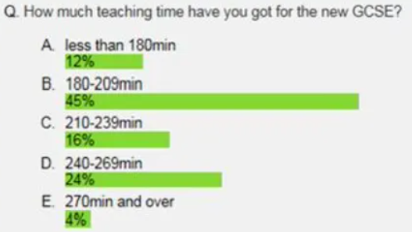
AQA Twitter poll, 2015 (via @just_maths)
( ~ 3.5 hours per week on average)
(https://justmaths.co.uk/2015/07/16/teaching-time/)

Slide 9
~600 hours at secondary school
(Mark McCourt, Teaching for Mastery, 2019)
 | High performing schools | Average performing schools
Settling | 5 minutes | 8 minutes
Starter | 0 minutes | 12 minutes
Disruption | 5 minutes | 5 minutes
Packing up | 1 minute | 4 minutes
Total | 11 minutes | 29 minutes
Up-Time | 49 minutes | 31 minutes

Slide 10
18 minutes more teaching time per lesson
 | High performing schools | Average performing schools
Down-time | 11 minutes | 29 minutes
Up-Time | 49 minutes | 31 minutes

Slide 11
30% more teaching time at secondary school
 | High performing schools | Average performing schools
Down-time | 11 minutes | 29 minutes
Up-Time | 49 minutes | 31 minutes

Slide 12
180 more hours of time spent teaching during students’ time at secondary school
 | High performing schools | Average performing schools
Down-time | 11 minutes | 29 minutes
Up-Time | 49 minutes | 31 minutes

Slide 13
 | High performing schools | Average performing schools
Settling | 5 minutes | 8 minutes
Starter | 0 minutes | 12 minutes
Disruption | 5 minutes | 5 minutes
Packing up | 1 minute | 4 minutes
Total | 11 minutes | 29 minutes
Up-Time | 49 minutes | 31 minutes

Slide 14
disruption

Slide 15
It happens

Slide 16
“You promote what you permit”

Slide 17
Follow the behaviour system within your setting

Slide 18
Set the tone

Slide 19
SLANT/STAR

Slide 20
routines

Slide 21
“Excellence is not an act, but a habit”
- Aristotle

Slide 22
Average performing schools
8 minutes per lesson to settle
12 minutes on a starter
20 minutes in total

Slide 23
Average performing schools take 8 minutes of each lesson settling
Lining up outside
Handing out books, equipment

Slide 24
Environment

Slide 25
Stand at the door and greet every student by name

Slide 26
Collecting books
Average performing schools spend 4 minutes of each lesson packing up

Slide 27
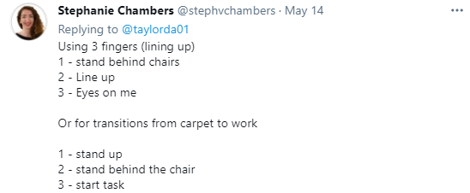
Teach routines
Be clear about them, don’t assume

Slide 28
starters

Slide 29
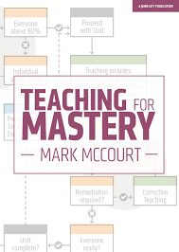
“Don’t do them”
Average performing schools
= 12 minutes per lesson
= 20% of teaching time

Slide 30
“The lesson hasn’t started yet”
“They’re not important”

Slide 31
But what if it’s school policy?
Give 2 or 3 questions
not 10-20 minutes

Slide 32
Last lesson/last week/last month/last year

Slide 33
time (in lessons)

Slide 34
Teach
Do
Practice
Behave

Slide 35
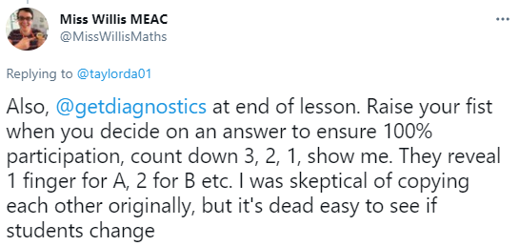
Teach, Do, Practice, Behave
Whole class response systems

Slide 36
Teach, Do, Practice, Behave
No learning occurs during the ‘doing’ phase
So why bother spending 15 minutes on a thirty-question activity?
Give a 5-minute activity and save 10 minutes

Slide 37
Teach, Do, Practice, Behave
1, 5, 30, 89 days later
Use the saved time to be more impactful with activities
(Mark McCourt, Teaching for Mastery, 2019)

Slide 38
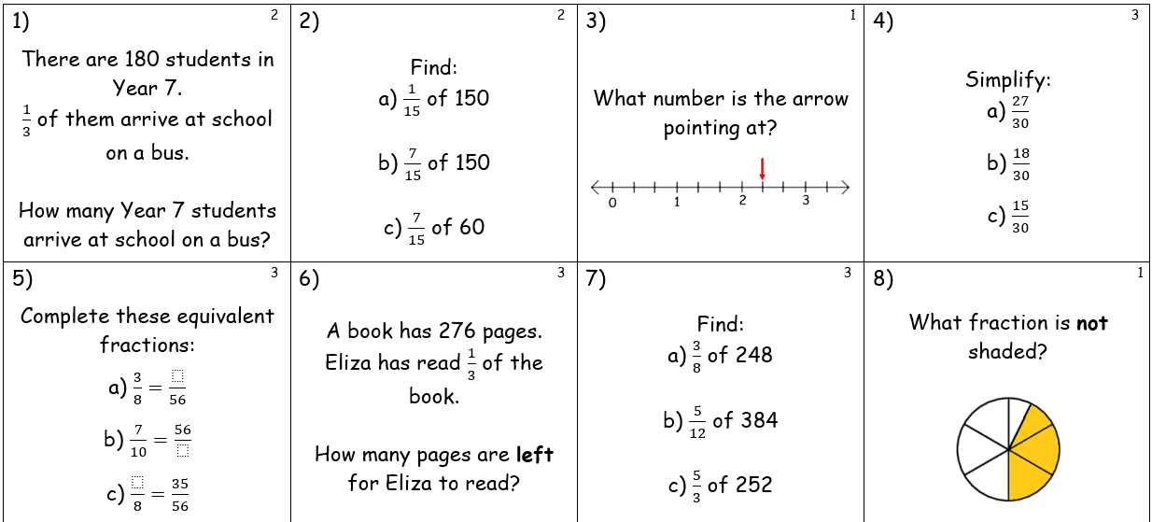
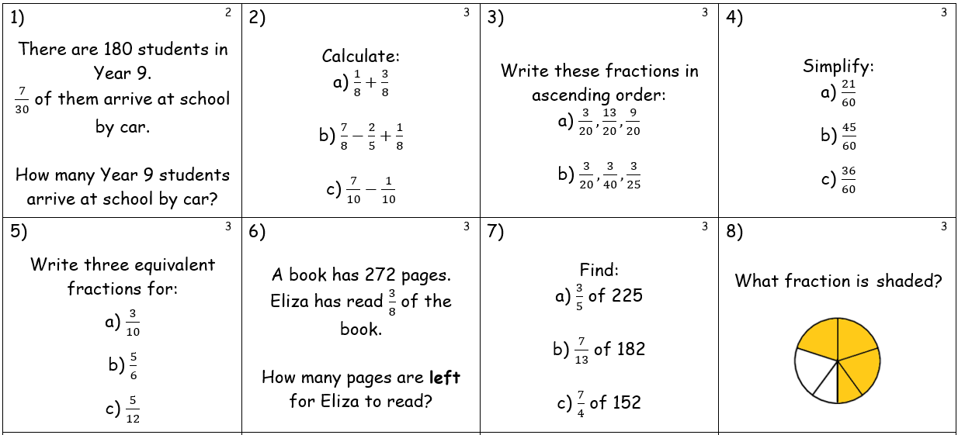
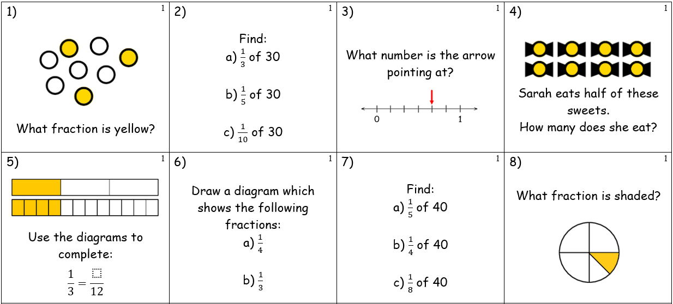
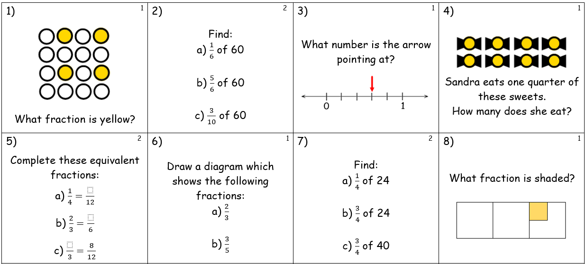
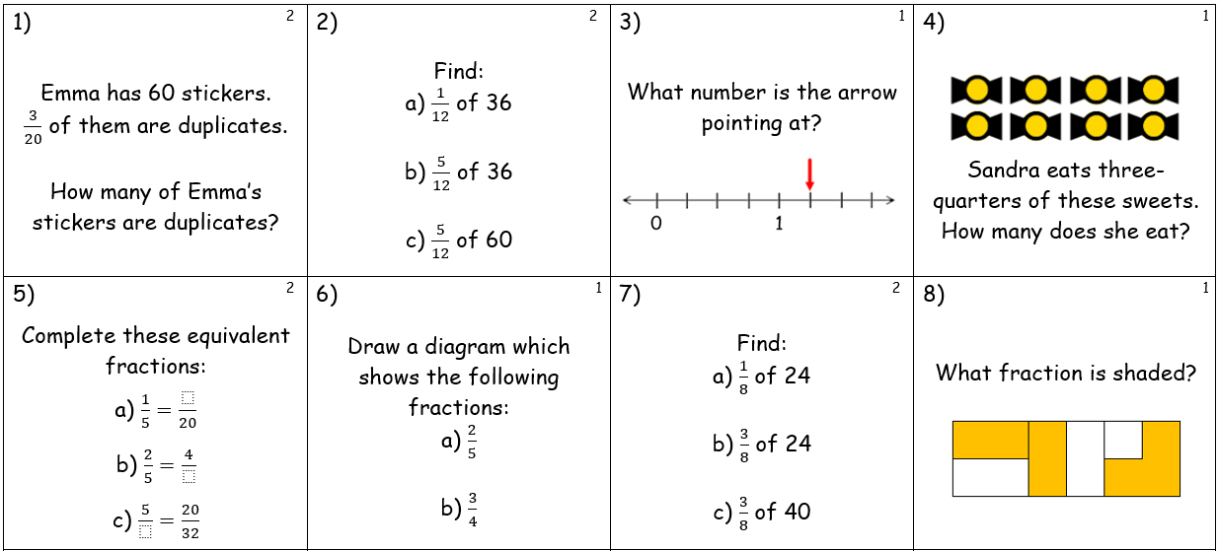
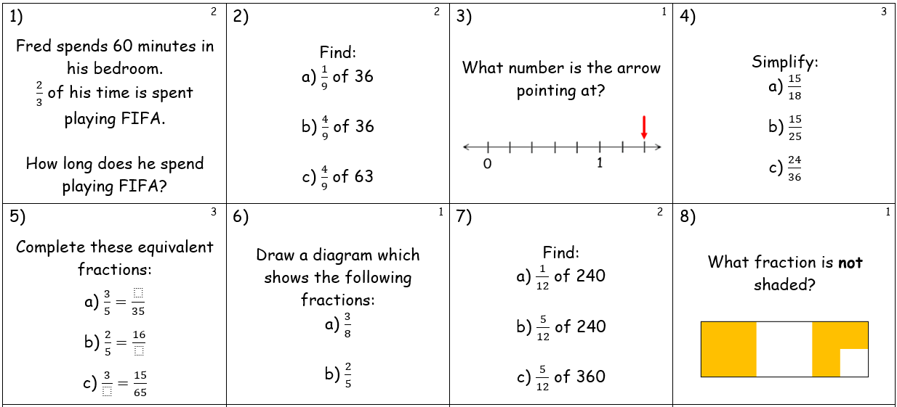
An example: Fractions
Recognise and use fractions as numbers
Recognise and find simple fractions of a set of objects
Calculate simple unit fractions of amounts
Recognise and show, using diagrams, simple equivalent fractions
Calculate simple fractions of amounts
Recognise and show, using diagrams, families of equivalent fractions
Solve problems that involve fractions of a set of objects
Write equivalent fractions of a given fraction
Use common factors to simplify fractions
Calculate more complex fractions of amounts
Compare and order unit fractions
Compare and order fractions in the same denominator
Add and subtract fractions with the same denominator

Slide 39
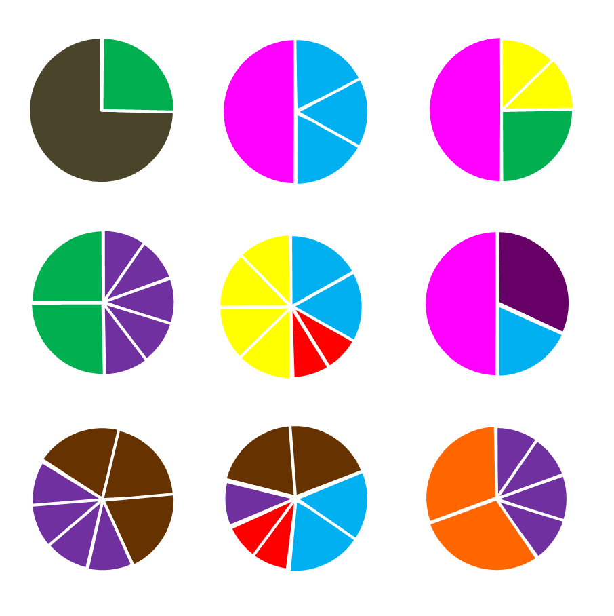
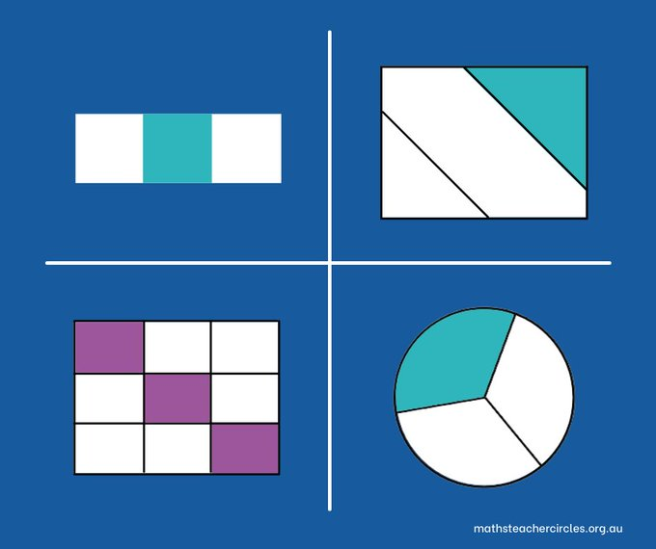
Teach, Do, Practice, Behave
2 years’ maturation
Recognise and use fractions as numbers
Compare and order unit fractions
Compare and order fractions in the same denominator
Add and subtract fractions with the same denominator

Slide 40
time (outside of lessons)

Slide 41
Homework
1, 5, 30, 89 days later
Last lesson/week/month/year

Slide 42
Breakfast/Lunch time/After school clubs
TUTOR
Meet students where they are, not where they should be

Slide 43
Got more sway?
Subject specific tutor groups

Slide 44
up-time @taylorda01 dave.taylor@completemaths.com

Slide 45
maximising up-time @taylorda01 dave.taylor@completemaths.com

