Slide 1
Getting Teacher Assessment Right
Mark McCourt @EmathsUK

Slide 2
Why ‘right’?
Pupils have the right to the right assessments, designed and administered rightly to give a right view of their attainment.
It is the only right thing to do.
Notes:
Pupils have the right to know and be able to celebrate the culmination of their studies – in many cases, this is 10 or more years. The exam specification is just one small sample. To argue that exams should not go ahead because pupils have missed weeks at school from a 10 or more year window makes no sense. It is not the job of exams to be fair.

Slide 3
What do we mean by ‘teacher assessment’?
…assessment where the professional judgement of teachers has a significant role in drawing inferences and making judgements, as well as in gathering evidence for assessment.
Harlen et al, 2004

Slide 4
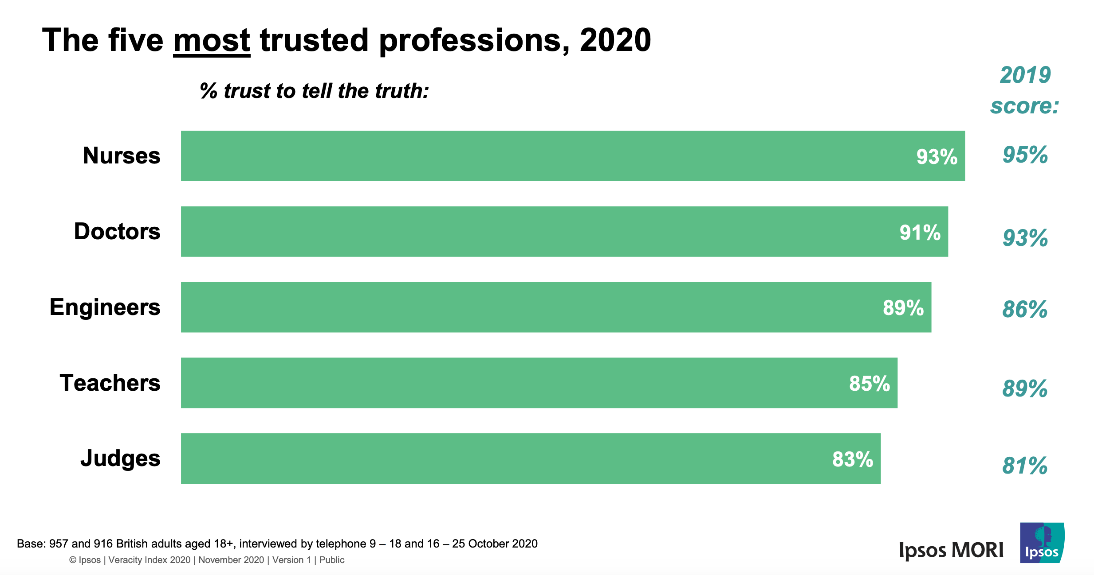
Trust

Slide 5
Reasons I assess
As a teacher, I ask pupils questions in order to work out how I should act differently
To give me and the pupils an indication of how mathematical they are becoming over time
To establish the curriculum pathways with the highest likelihood of success for each and every pupil
To provide all pupils with the tradeable commodity of a grade

Slide 6
What are we assessing?
Domain
Curriculum
Syllabus
Exam

Slide 7
Some known proxies for far transfer in mathematics
Bridging instruction
Multiple representations
Interleaving
Removing recency
Removing cue
…and other desirable difficulties (read my book 😉)

Slide 8
Which do you prefer?
Panasuk & Beyranevand, 2011

Slide 9
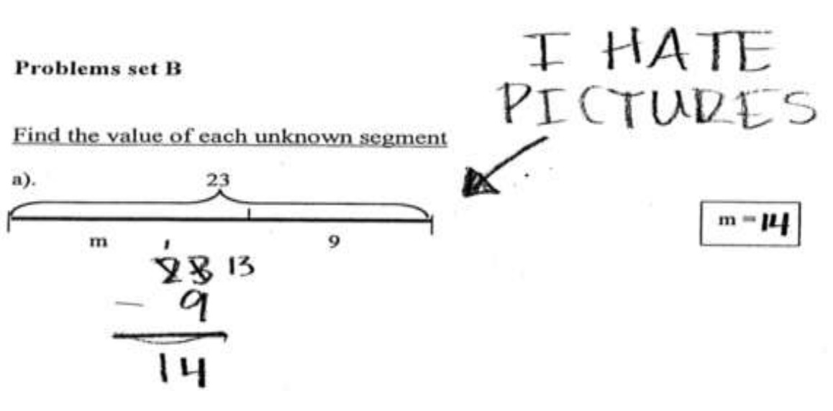
Panasuk & Beyranevand, 2011

Slide 10
Describe the symbols using story and images
8 × 4
2 × 3 × 4
102 ÷ 9
4x + 5 = 21
8h(4h + 3g)
2 × π² × R × r²
y = 2x – 3
32 – 68

Slide 11
The didactics of mathematics
James Fey considered this preparing of technically detailed and true mathematics for the teaching process as one of ‘elementarization’.
As Fey puts it:
the translation of mathematical concepts, principles, techniques, and reasoning methods from the forms in which they are discovered and then verified by formal reasoning to forms that can be learned readily by a broad audience of students

Slide 12
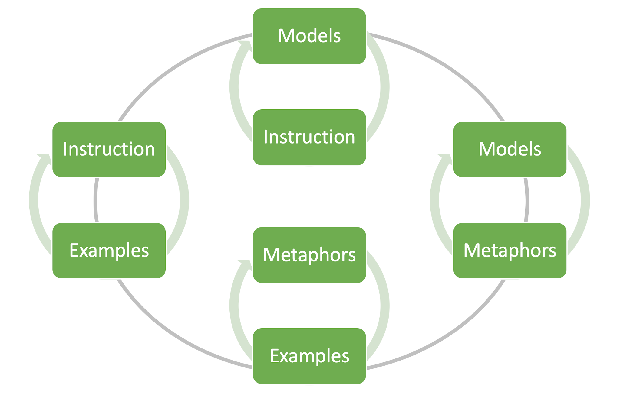
Instruction, Examples, Models and Metaphors

Slide 15
Recency and cue

Slide 16
SPUR

Slide 17
Why exams?
The least worst approach we have for establishing an understanding of a pupil’s likely grasp of a domain

Slide 18
Reliability
Reliability refers to the consistency of measurement
Bathroom scales
Can be reliable, but inaccurate
Notes:
Reliability refers to the consistency of measurement. Reliable scores show little inconsistency from one measurement to the next. So for a test to be reliable it has to provide consistent results across time. If I sit a GCSE in English one day and I sit it again the next day (obviously having done nothing in between that might improve my score), then if the test is reliable I should get the same score. If I weigh myself on a set of bathroom scales several times in a row, then if the scales are reliable I should get the same reading every time.
A test can be reliable but inaccurate. The GCSE could give me the same score both times, but it could be the wrong score. The scales could tell me I am the same weight every time, but it could be the wrong weight.

Slide 19
Validity
Validity refers to the inferences one makes based on a test
Does a good mark on a statistics exam allow you to infer a pupil’s ability in mathematics?
What about worded problems?
How to deal with construct underrepresentation?
How to deal with construct-irrelevance variance?
Notes:
Validity can be compromised in many ways – Koretz explains three. First, in order to make a valid inference about a pupil’s ability in a particular domain, you have to make sure the test adequately samples from that domain. If you don’t, this is called construct underrepresentation. Your test fails to adequately represent the construct that you want to make inferences about.
The opposite problem is also possible – when you test more than you are trying to make the inference about. This makes it hard to isolate an exact skill that you can make an inference about. This is construct-irrelevance variance. Finally, there are cases when a test that normally allows us to make valid inferences is used in such a way that it compromises that validity – teaching to the test and such like.

Slide 20
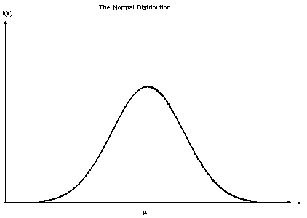
Criterion vs norm referenced
Notes:
Norm-referenced tests are specifically designed to rank test takers on a “bell curve,” or a distribution of scores that resembles, when graphed, the outline of a bell—i.e., a small percentage of students performing well, most performing average, and a small percentage performing poorly. To produce a bell curve each time, test questions are carefully designed to accentuate performance differences among test takers, not to determine if students have achieved specified learning standards, learned certain material, or acquired specific skills and knowledge. Tests that measure performance against a fixed set of standards or criteria are called criterion-referenced tests.

Slide 21
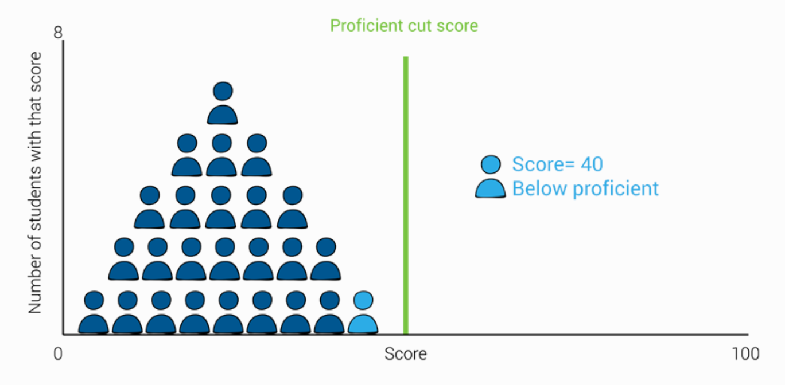
Criterion vs norm referenced

Slide 22
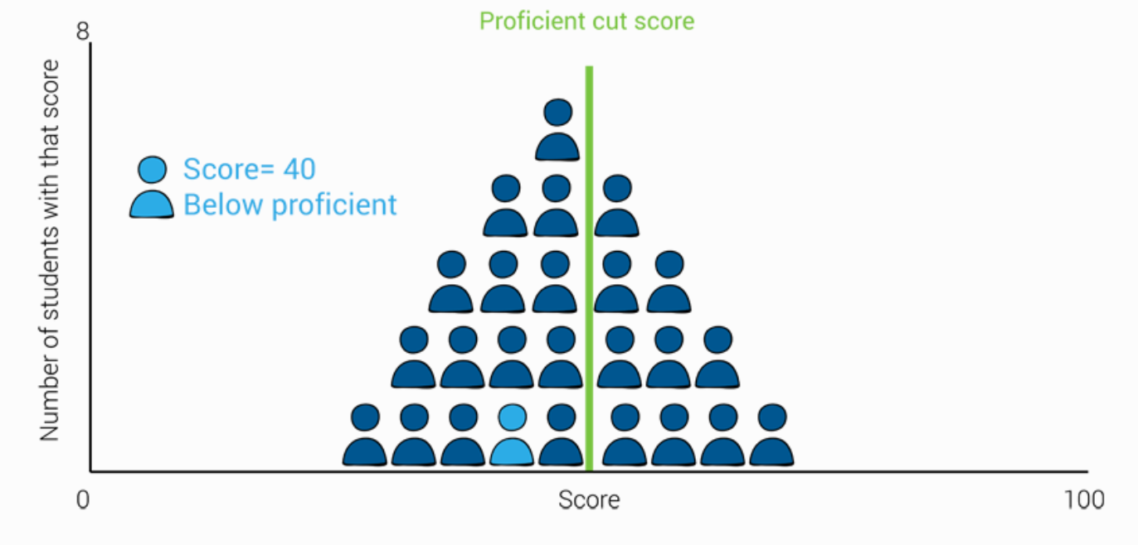
Criterion vs norm referenced

Slide 23
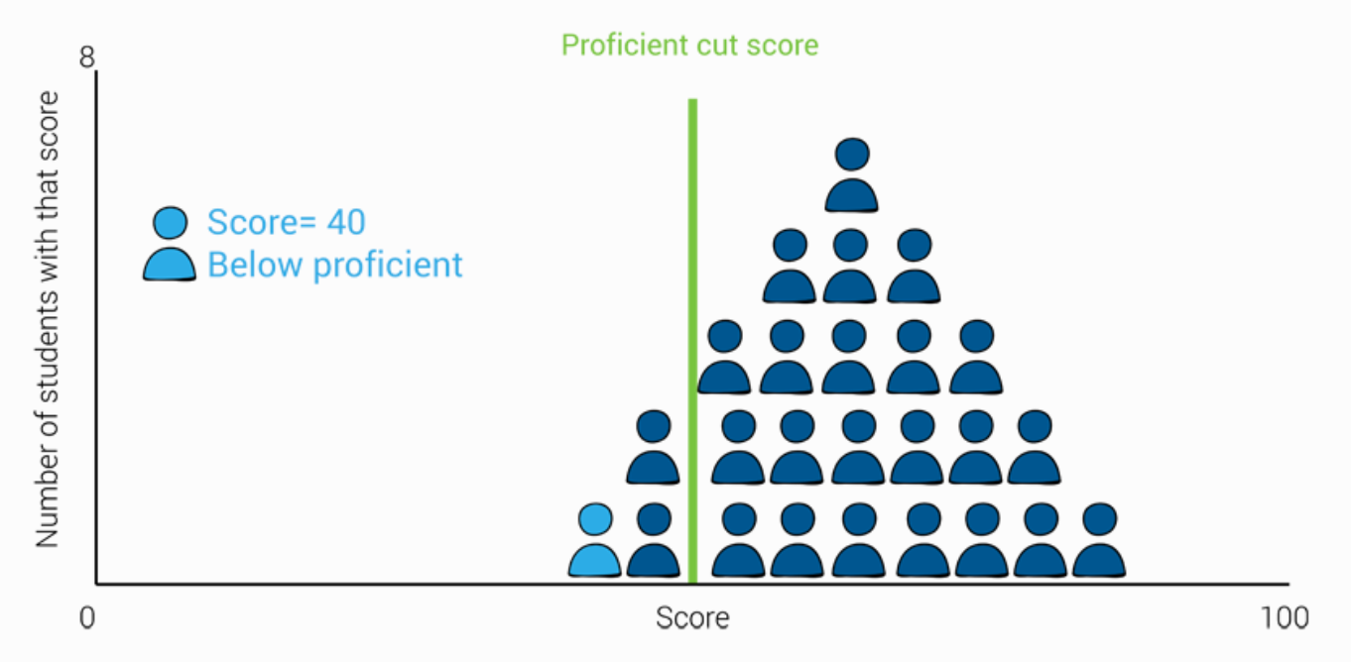
Criterion vs norm referenced

Slide 24
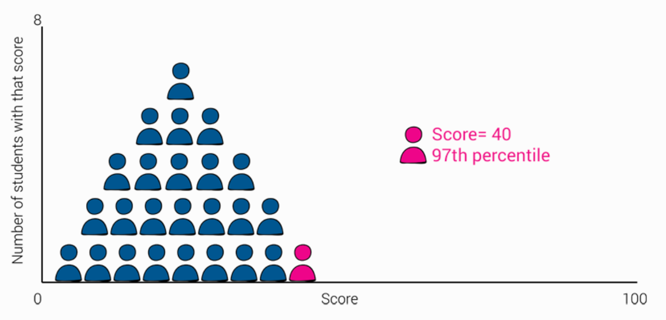
Criterion vs norm referenced

Slide 25
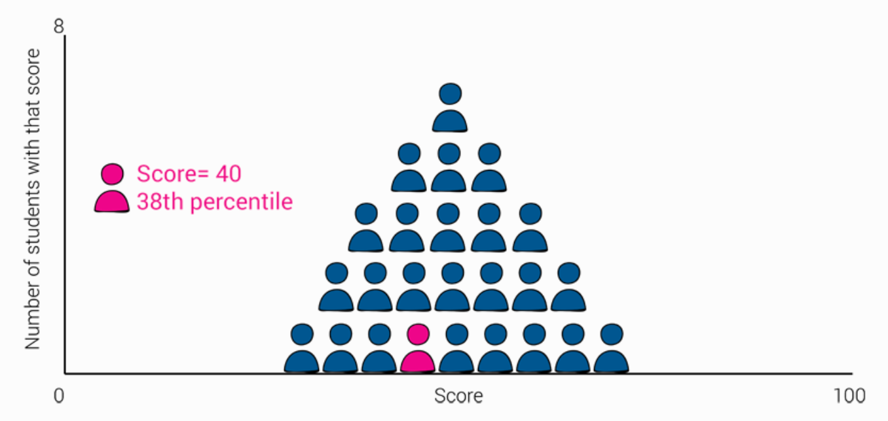
Criterion vs norm referenced

Slide 26
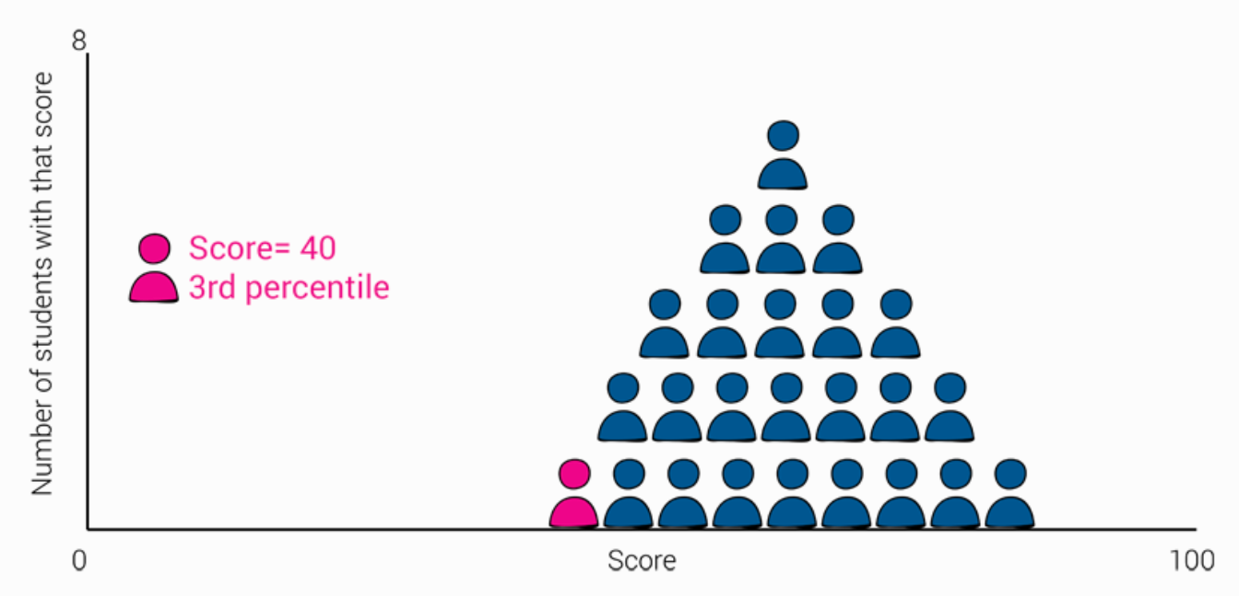
Criterion vs norm referenced

Slide 27
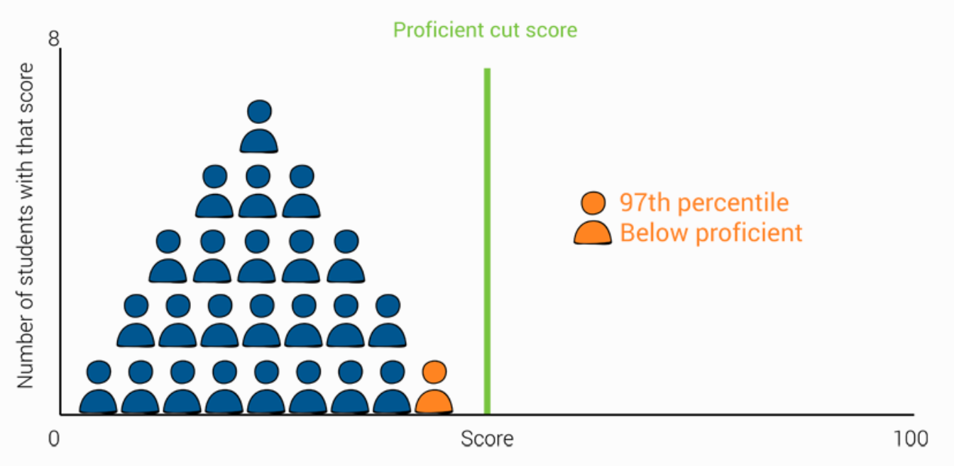
Criterion vs norm referenced

Slide 28
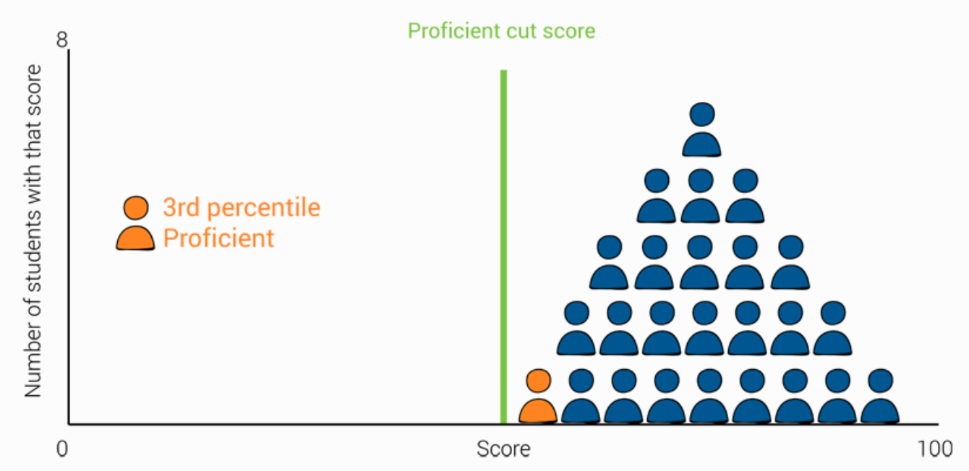
Criterion vs norm referenced

Slide 29
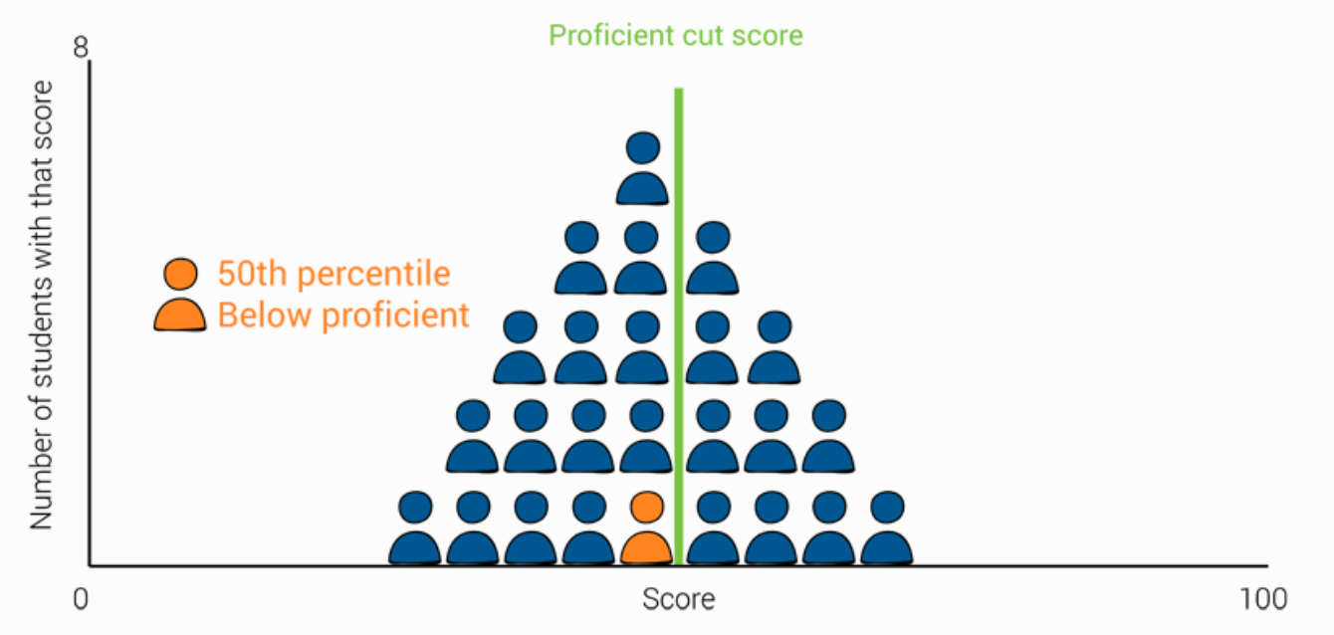
Criterion vs norm referenced

Slide 30
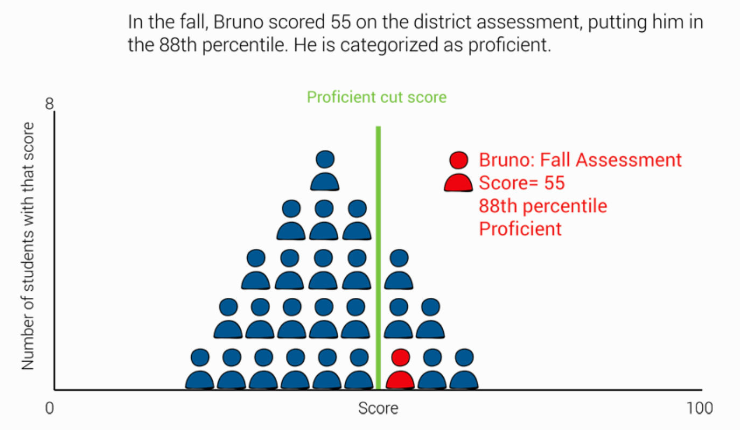
Criterion vs norm referenced

Slide 31
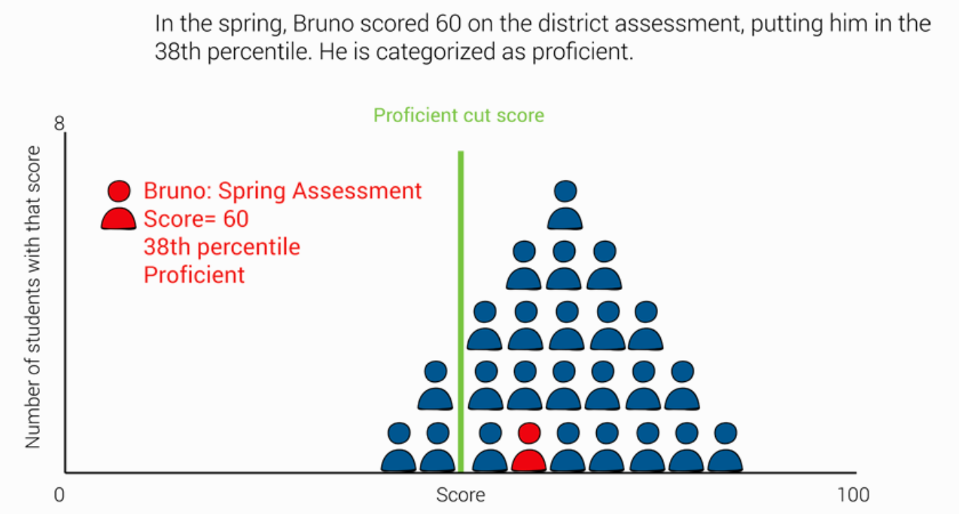
Criterion vs norm referenced

Slide 32
Pros or cons?
Working more effectively
Teaching more
Working harder
Reallocation
Alignment
Coaching
Cheating

Slide 33
Pros or cons?
Working more effectively
Teaching more
Working harder
Reallocation
Alignment
Coaching
Cheating
Notes:
Reallocation refers to shifting instructional resources—classroom time, homework, parental nagging, whatever—to better match the content of a specific test.
A quarter century of studies confirm that many teachers reallocate instruction in response to tests.
And some studies have found that school administrators reassign teachers to place the most effective ones in the grades in which important tests are given.
Is reallocation good or bad? Does it generate real gains in achievement or score inflation? This depends on what gets more emphasis, and what gets less. Some reallocation is desirable and is one of the goals of testing programs. For example, if a ninth-grade math test shows that students do relatively poorly in solving basic algebraic equations, one would want their teachers to put more emphasis on such equations. The rub is that devoting more resources to topic A entails fewer resources for topic B. Scores become inflated when topic B—the material that gets less emphasis as a result of reallocation—is also an important part of the domain. If teachers respond to a test by de-emphasizing material that is important to the domain but is not given much weight on the particular test, scores will become inflated. Performance will be weaker when students take another test that places emphasis on those parts of the domain that have been neglected
Alignment is a lynchpin of policy in this era of standards-based testing. Tests should be aligned with standards, and instruction should be aligned with both. And alignment is seen by many as insurance against score inflation, but this is incorrect. Alignment is just reallocation by another name. Whether alignment inflates scores also depends on the importance of the material that is de-emphasized. And research has shown that standards-based tests are not immune to this problem. These tests are still limited samples from larger domains, and therefore focusing too narrowly on the content of the specific test can inflate scores.
Coaching students refers to focusing instruction on small details of the test, many of which have no substantive meaning. Coaching need not inflate scores. If the format or content of a test is sufficiently unfamiliar, a modest amount of coaching may even increase the validity of scores. For example, the first time young students are given a test that requires filling in bubbles on an answer sheet that is going to be scored by a machine, it is worth spending a very short time familiarizing them with this procedure before they start the test. Most often, however, coaching students either wastes time or inflates scores. A good example is training students to use a process of elimination in answering multiple-choice questions. A Princeton Review test-prep manual urges students to do this because “it’s often easier to identify the wrong answers than to find the correct one.”2 What’s wrong with this? The performance gains generated depend entirely on using multiple-choice items. Of course, when students need to apply their knowledge in the real world outside of school, the tasks are unlikely to appear in the form of a multiple-choice item. This example shows that inflation from coaching is in one respect unlike inflation from reallocation. Reallocation inflates scores by making performance on the test unrepresentative of the larger domain, but it does not distort performance on the material tested. (If I taught applicants the vocabulary words on your test, they would know those words—but their scores on the test would not be good estimates of their overall vocabulary knowledge.) In contrast, coaching can exaggerate performance on the tested material. In the example just given, students who are taught to use the process of elimination as a method for “solving” certain types of equations will know less about those types of equations than their performance on the test indicates. So what distinguishes good and bad test prep? The acid test is whether the gains in scores produced by test preparation truly represent meaningful gains in student achievement. We should not care very much about a score on a particular test. What we should be concerned about is the knowledge and skills that the test score is intended to represent. Gains that are specific to a particular test and that do not generalize to other measures of the domain and to performance in the real world are worthless.

Slide 34
The importance of externality
Removal of bias...
… in curriculum design
… in teaching
… in designing questions
… in administering
… in marking
… in grading

Slide 35
Comparing teacher assessment to test scores
Ethnicity | TA < Test | TA = Test | TA > Test
White
Black Caribbean
Black African
Indian
Pakistani
Bangladeshi
Chinese
Burgess and Greaves, 2009
Notes:
These findings are supported by Campbell, T. (2015) Stereotyped at Seven? Biases in Teacher Judgement of Pupils’ Ability and Attainment. Journal of Social Policy, 44:3, pp 517-547.

Slide 36
Comparing teacher assessment to test scores
Ethnicity | TA < Test | TA = Test | TA > Test
White |  | 82.5
Black Caribbean |  | 81.3
Black African |  | 81.0
Indian |  | 80.5
Pakistani |  | 80.3
Bangladeshi |  | 81.0
Chinese |  | 81.1
Burgess and Greaves, 2009

Slide 37
Comparing teacher assessment to test scores
Ethnicity | TA < Test | TA = Test | TA > Test
White | 7.9 | 82.5 | 9.6
Black Caribbean |  | 81.3
Black African |  | 81.0
Indian |  | 80.5
Pakistani |  | 80.3
Bangladeshi |  | 81.0
Chinese |  | 81.1
Burgess and Greaves, 2009

Slide 38
Comparing teacher assessment to test scores
Ethnicity | TA < Test | TA = Test | TA > Test
White | 7.9 | 82.5 | 9.6
Black Caribbean | 10.2 | 81.3 | 8.5
Black African | 10.6 | 81.0 | 8.4
Indian | 8.4 | 80.5 | 11.1
Pakistani | 11.9 | 80.3 | 7.8
Bangladeshi | 11.2 | 81.0 | 7.8
Chinese | 6.0 | 81.1 | 12.9
Burgess and Greaves, 2009

Slide 39
Comparing teacher assessment to test scores
Special Education Needs | TA < Test | TA = Test | TA > Test
No SEN
SEN, without statement
SEN, with statement
Burgess and Greaves, 2009

Slide 40
Comparing teacher assessment to test scores
Special Education Needs | TA < Test | TA = Test | TA > Test
No SEN |  | 83.3
SEN, without statement |  | 77.5
SEN, with statement |  | 73.2
Burgess and Greaves, 2009

Slide 41
Comparing teacher assessment to test scores
Special Education Needs | TA < Test | TA = Test | TA > Test
No SEN | 6.0 | 83.3 | 10.7
SEN, without statement | 19.3 | 77.5 | 3.3
SEN, with statement | 22.2 | 73.2 | 4.5
Burgess and Greaves, 2009

Slide 42
Comparing teacher assessment to test scores
Free School Meals | TA < Test | TA = Test | TA > Test
No FSM
FSM
Burgess and Greaves, 2009

Slide 43
Comparing teacher assessment to test scores
Free School Meals | TA < Test | TA = Test | TA > Test
No FSM |  | 82.4
FSM |  | 81.5
Burgess and Greaves, 2009

Slide 44
Comparing teacher assessment to test scores
Free School Meals | TA < Test | TA = Test | TA > Test
No FSM | 7.5 | 82.4 | 10.1
FSM | 11.9 | 81.5 | 6.6
Burgess and Greaves, 2009

Slide 45
Comparing teacher assessment to test scores
English as an additional language | TA < Test | TA = Test | TA > Test
Not EAL
EAL
Burgess and Greaves, 2009

Slide 46
Comparing teacher assessment to test scores
English as an additional language | TA < Test | TA = Test | TA > Test
Not EAL | 7.9 | 82.5 | 9.6
EAL | 10.6 | 80.6 | 8.8
Burgess and Greaves, 2009

Slide 47
Given that setting in secondary school classes may depend on earlier recorded attainment and that motivation may also be affected by a lower level, the use of assessment rather than testing may increase attainment gaps between ethnic groups later in academic life.

Slide 48
Ingredients for increasing the likelihood of reliability and validity
Externality
Unpredictable format
Teaching to the domain, not the syllabus
Blind marking (double blind is better than moderation)

Slide 49
Sensible and productive uses of tests and test scores rest on a single principle: don’t treat “her score on the test” as a synonym for “what she has learned.” A test score is just one indicator of what a student has learned—an exceptionally useful one in many ways, but nonetheless one that is unavoidably incomplete and somewhat error-prone.
Daniel Koretz

Slide 50
Reasons I assess
As a teacher, I ask pupils questions in order to work out how I should act differently
To give me and the pupils an indication of how mathematical they are becoming over time
To establish the curriculum pathways with the highest likelihood of success for each and every pupil
To provide all pupils with the tradeable commodity of a grade

Slide 51
CompleteMaths.com

